Slide 1
Urban Heat: Green Roofs to Decrease Solar Heat in Downtown Paraná.
Universidad Tecnológica Nacional, Facultad Regional Paraná, Civil Engineering Department, Inglés II
Author: Soliard, Andrés
This work is an EFL engineering student project. The pictures and content in this presentation are only used for educational purposes. If there is any copyright conflict, they will be immediately removed.

Slide 2
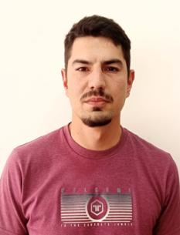
Author information
Andrés Soliard.
Born in Paraná, Entre Ríos
32 years old
Civil Engineering

Slide 3
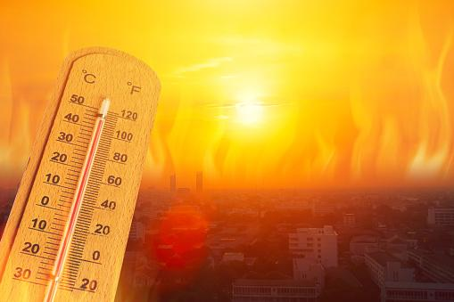

Introduction

Slide 4
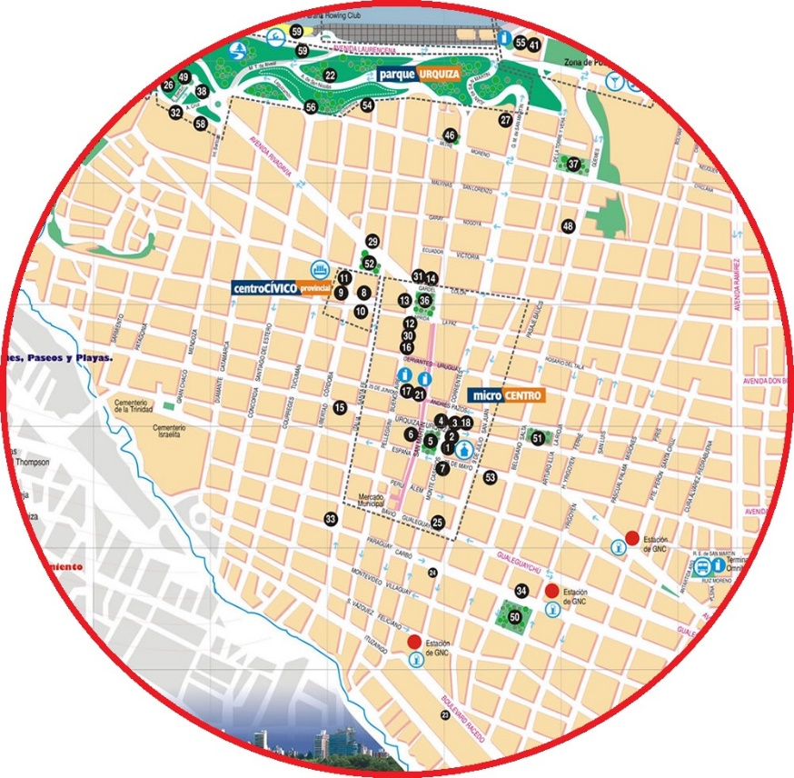
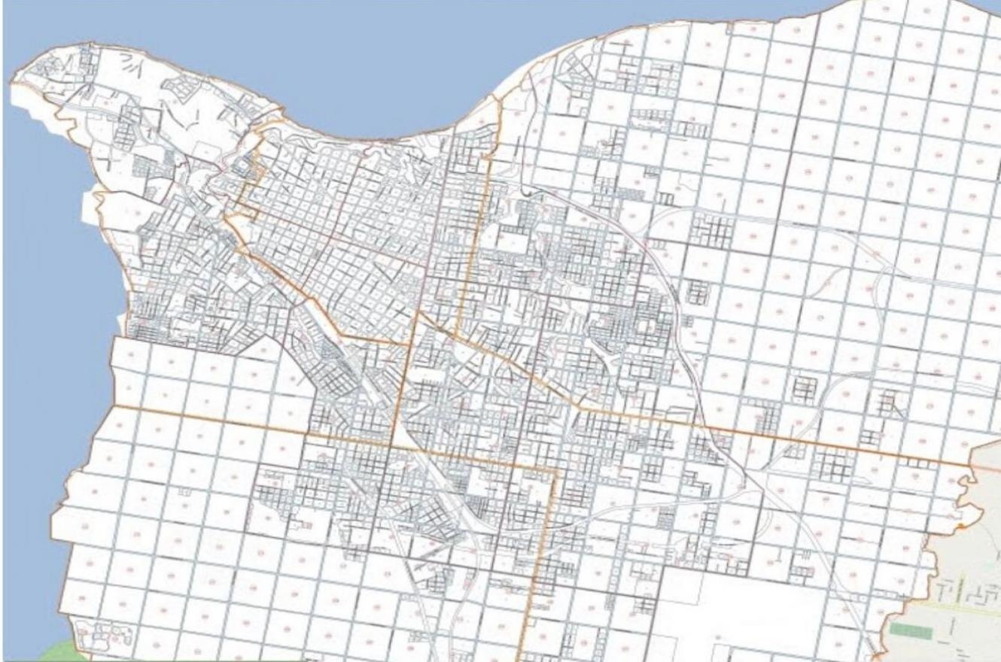
Center of Paraná city

Slide 5
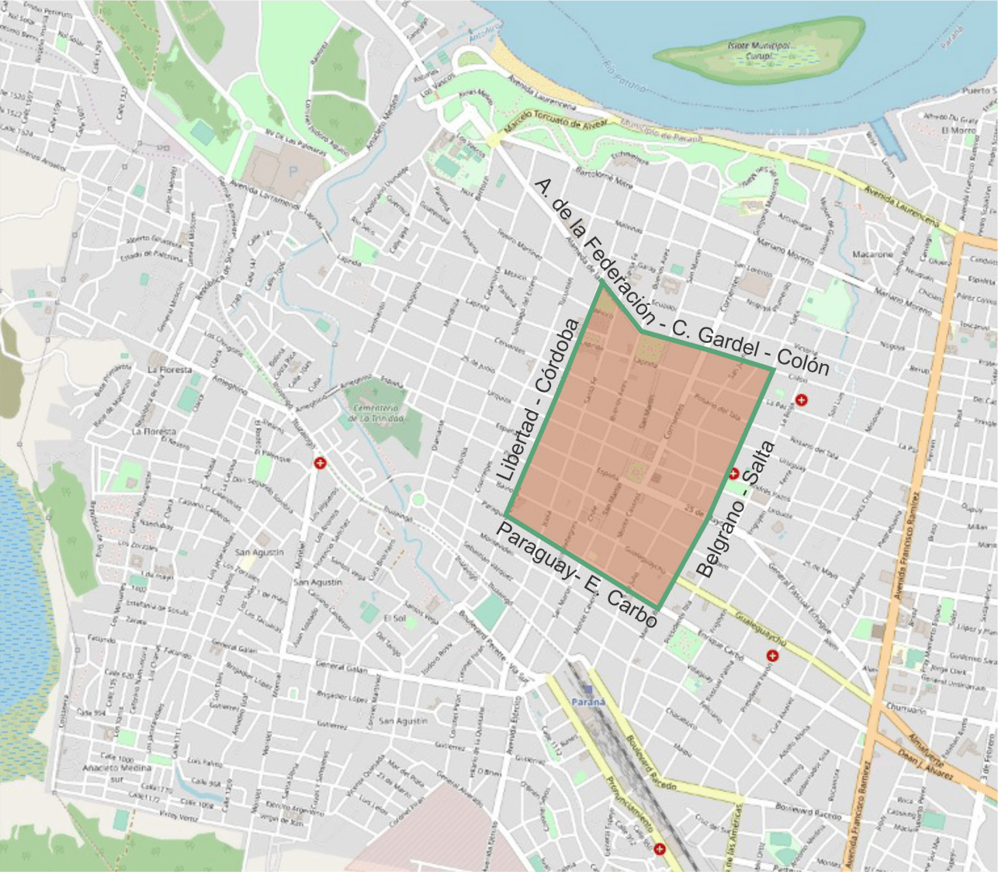
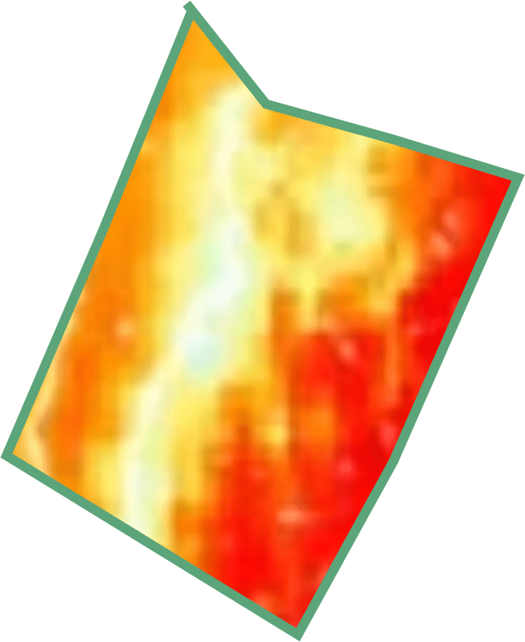
The problem addressed takes into account the following aspects:
Prolonged periods of high temperature in hot seasons
Area of ​​little space available for vegetation.
Area with a lot of cement and asphalt.

Slide 6
Map of the presentation
1º Description of the characteristics of the area
2º Presentation of the problem
6º Proposal to address the problem
3º Visible effects of the problem
4º Causes of the problem
7º Strengths and Weaknesses
5º Consequences of the problem

Slide 7
Problem Definition
and Analysis

Slide 8
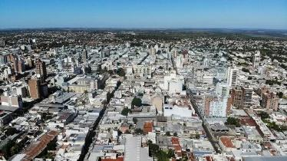
Description of the Context
Busy place
Lots of cars parked and traffic
A lot of pollution
A lot of noise contamination
Average height buildings
High rate of land use

Slide 9
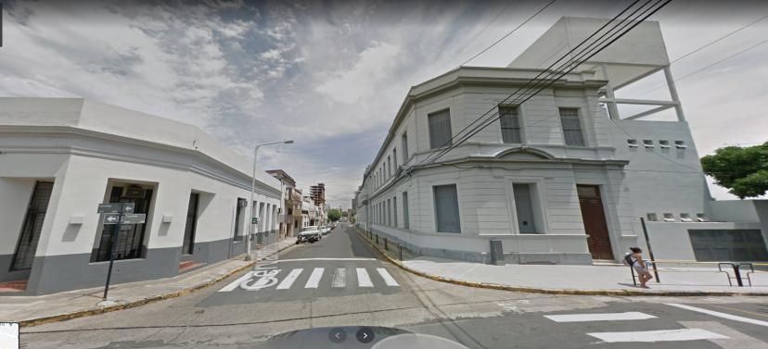
Tucumán Street
Many housing buildings
Many shops
Rivadavia School
Narrow street
Little space for the sidewalks

Slide 10
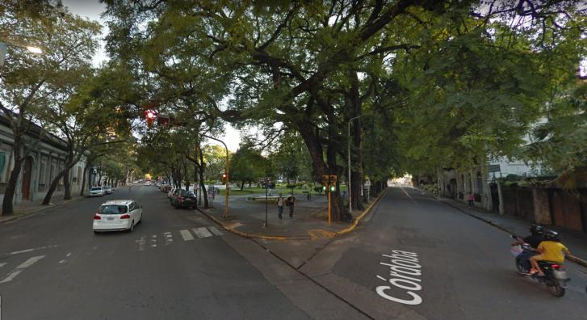
Alameda de la Federación street
Wide road and wide sidewalks
Tree lines along both sides
Beautiful houses and elegant shop
Centenario School
Carbó Square

Slide 11
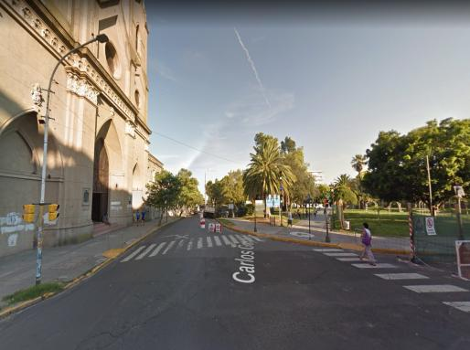
Colón Street
San Miguel Arcángel Parish
Narrow street
A lot of traffic
Many trees along this street
Tall buildings

Slide 12
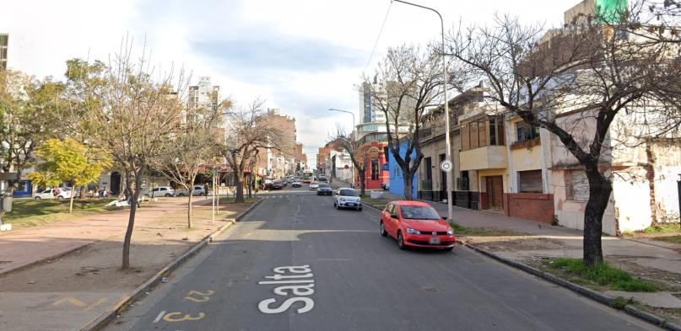
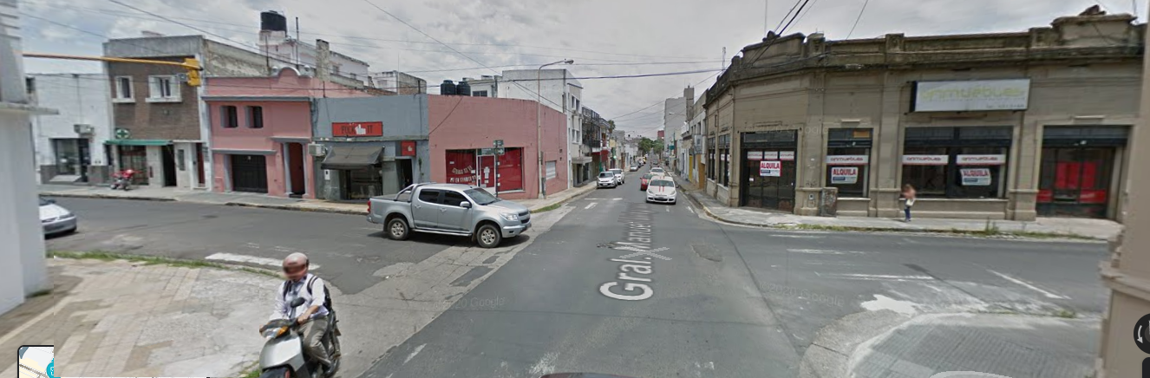
Salta street
Wide road
A lot of traffic
Many trees and vegetation
Beyond Urquiza street (Belgrano street)
No vegetation
Narrow street and sidewalks

Slide 13
Problem Statement
Córdoba and Libertad streets
Belgrano and Salta streets
Alameda de la Federación and Colon streets
Paraguay and Enrique Carbó

Slide 14
Description of the problematic situation

Slide 15
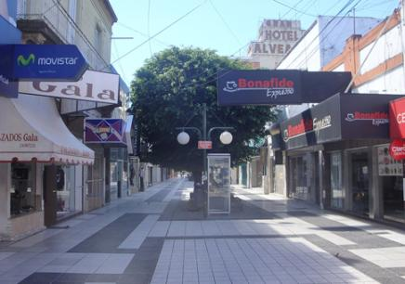
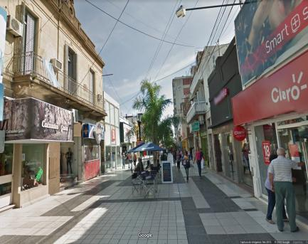
San Martín pedestrian street
2011
2019
Low trees with large top
People walking
People sitting in coffee chairs
A lot of shade
Young palms

Slide 16
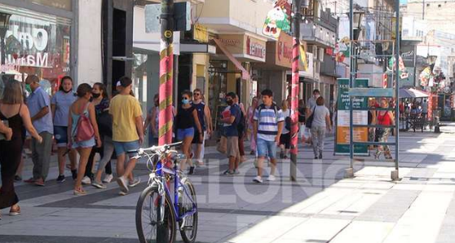
San Martín pedestrian street
People location preference
Little wind circulation

Slide 17
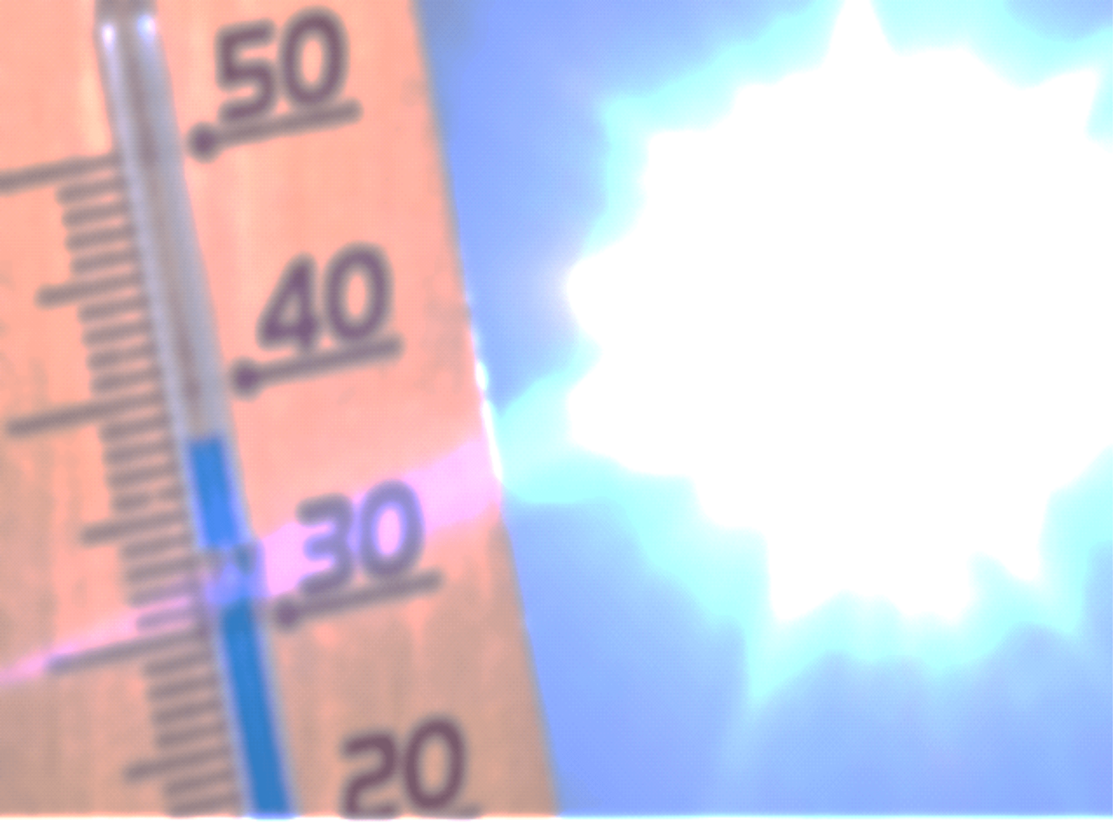
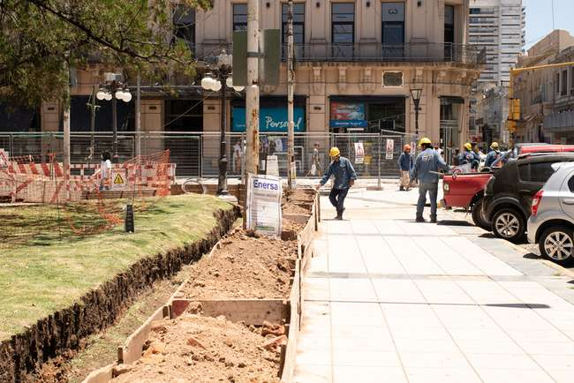
Primero de Mayo Square
Some shops
Medium-rise buildings
Widened sidewalks
Reduction of green spaces.

Slide 18
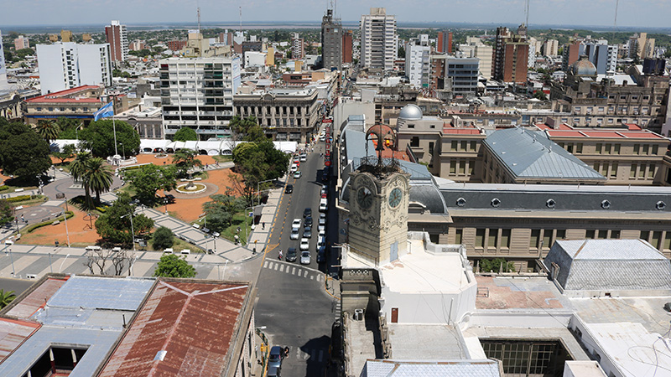

Slide 19
Causes and Factors of the Problem

Slide 20
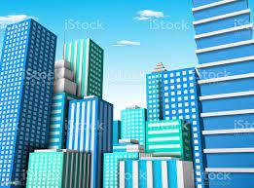
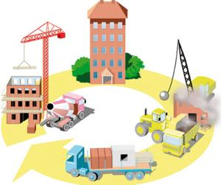
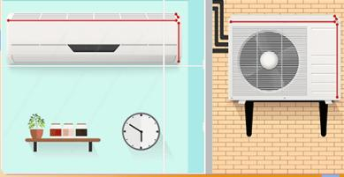



Causes and Factors
Construction of high-rise buildings.
Reduction of green spaces.
Use of air conditioners with outdoor units.

Slide 21
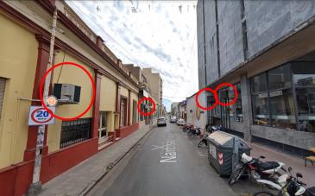
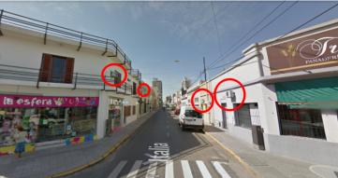
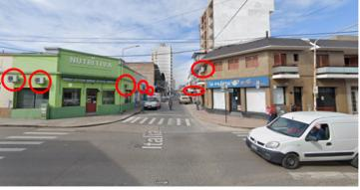
Consequences
Decrease in number of people in the area because of high temperature.
Less commercial and tourist activities
High cost of energy consumed because of air conditioning.

Slide 22
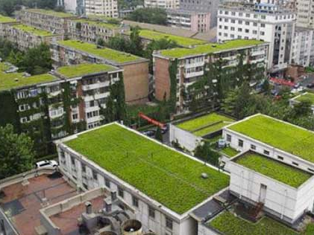
The Way Forward:
Green Roofs

Slide 23
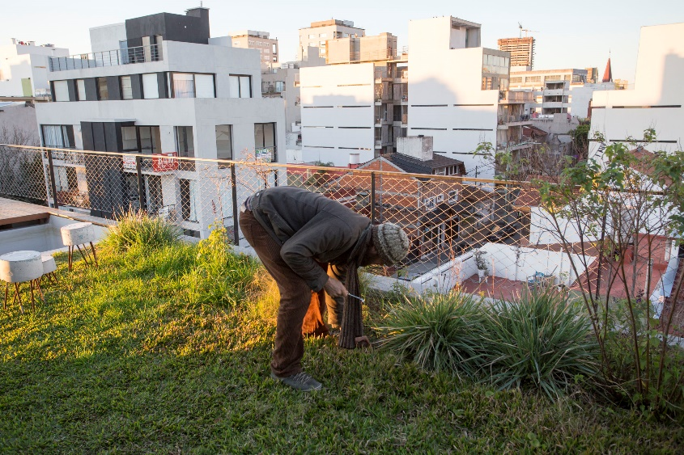
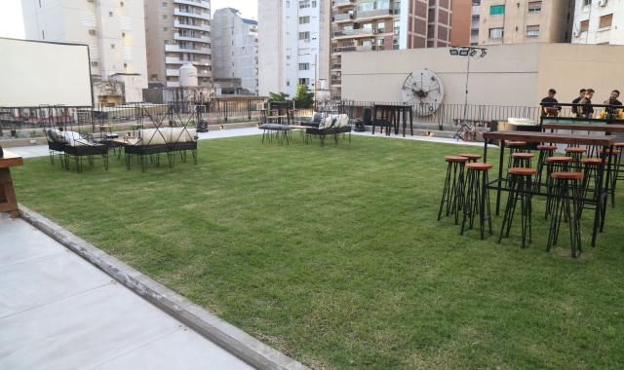
Problem approach
Limitation by areas already used by the construction
Implementation of green roofs in public buildings
Promotion of its use in shops and homes
Less heat reception in green roofs
Decrease in surrounding ambient temperature
Good thermal insulator for buildings and houses
Notes:
Acá hay dos estructuras con verbo y dos con sustantivos

Slide 24
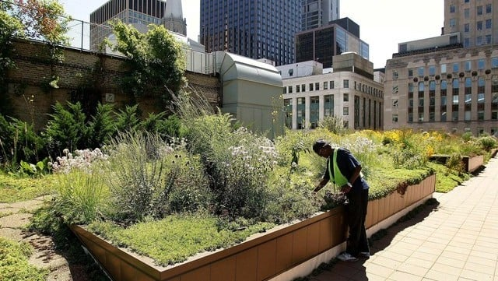
Strengths and Weaknesses of the Proposal
Need for constant care
Structural characteristics required
High cost

Slide 25
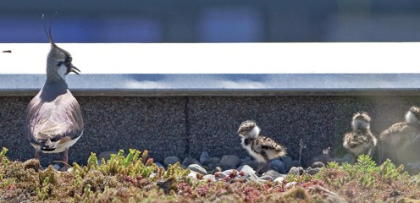
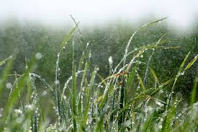
Strengths and Weaknesses of the Proposal
Maximized use of small spaces
Positive influence on the weather and nature
Rainwater absorption
Opportunity for job creation

Slide 26
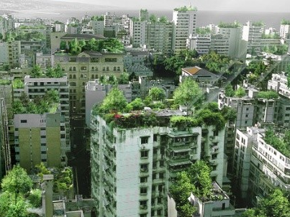
Conclusion
The installation of green roofs in public buildings aims to address the problem of high temperatures in the center of Paraná, because they lower the surrounding ambient temperature.

